Slide 1

Introdução a Numpy e Pandas
Event Code: #7751

Slide 2

Palestrante
Fabricio Murai
PhD, Professor Adjunto - DCC@UFMG
Speaker Bio: concluiu o B.Sc. (magna cum laude) pela UFRJ em 2007 e o Ph.D. pela Universidade de Massachusetts Amherst em 2016, ambos em Ciência da Computação. Em 2017, passou a integrar o corpo docente do DCC/UFMG. Desde então, tem lecionado cursos de fundamentos de álgebra linear para aprendizado de máquina, Aprendizado de Máquina para Redes e Deep Learning. Em 2018, foi convidado para lecionar o curso "Data Science for Networks" na Politecnico di Torino, Itália.

Slide 3
Agenda
19:30 Apresentação
21:30 Fim do evento
19:35 Numpy: usando arrays numéricos de forma efetiva
Title for Section 2. Size 20 pt
20:25 Intervalo de 5 minutos
Title for Section 3. Size 20 pt
20:30 Pandas: trabalhando com dados tabulares
Title for Section 4. Size 20 pt
21:10 Q&A
Title for Section 5. Size 20 pt
Há uma parada programada, mas fique à vontade para fazer uma pausa quando quiser.

Slide 4
Introdução a Numpy
Seção 1

Slide 5

Visão Geral da Seção 1
A cidade de Los Angeles usa NumPy para prever o despejo illegal de inquilinos de apartamentos youtu.be/JBFCsrPPEtc
Notes:
The City of Los Angeles uses NumPy (in conjunction with pandas) to predict illegal eviction of tenants from rent-controlled apartment buildings under the California Ellis Act (https://www.youtube.com/watch?v=JBFCsrPPEtc&t=5m43s). NumPy provides pre-compiled functions that are faster than regular Python functions (particularly on large datasets), and it is a standard numeric library for data science conducted using Python. It is also the foundation for another popular and important library we will examine later in the course: pandas.

Slide 6
Visão Geral da Seção 1
Por que NumPy?
Funções mais rápidas, pré-compiladas
Biblioteca numérica padrão para Ciência de Dados usando Python
Base para outras bibliotecas populares (como o pandas)
Notes:
The City of Los Angeles uses NumPy (in conjunction with pandas) to predict illegal eviction of tenants from rent-controlled apartment buildings under the California Ellis Act (https://www.youtube.com/watch?v=JBFCsrPPEtc&t=5m43s). NumPy provides pre-compiled functions that are faster than regular Python functions (particularly on large datasets), and it is a standard numeric library for data science conducted using Python. It is also the foundation for another popular and important library we will examine later in the course: pandas.

Slide 7

Visão Geral da Seção 1
Ajuda built-in
Arrays numpy
Criação
Atributos
Indexação
Reshaping
Quebra e concatenação
Fancy indexing
Ordenação
Agregações

Slide 8
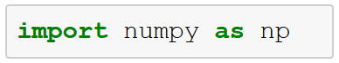
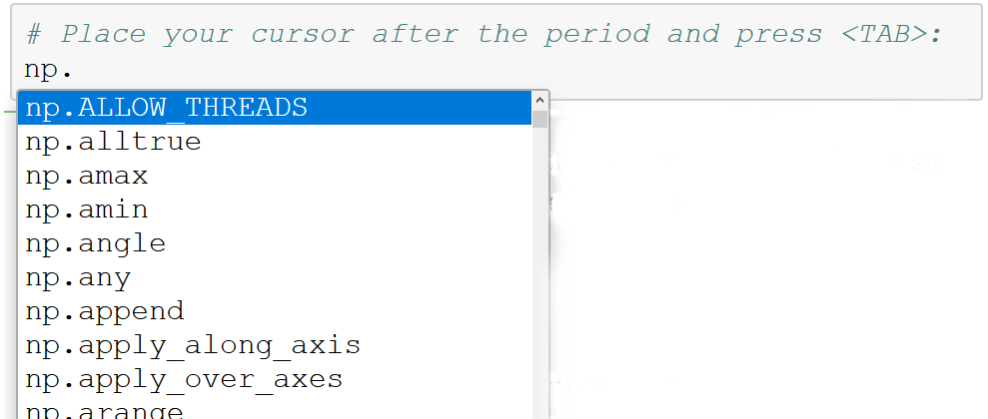

IPython e ajuda built-in
Use a Tecla tab para explorer o conteúdo dos pacotes.
Use “?” para informações de ajuda relacionadas a qualquer método.
Notes:
IPython is an interactive command-line terminal for Python and one of the main features of Jupyter notebooks. Code cells in Jupyter notebooks use IPython.
IPython gives you the ability to quickly explore the contents of a package like NumPy by using the tab-completion feature. So, if you want to see all of the functions available with NumPy, type this:
In [1]: np.<TAB>
Append “?” to any method to bring up the help info for that method.

Slide 9
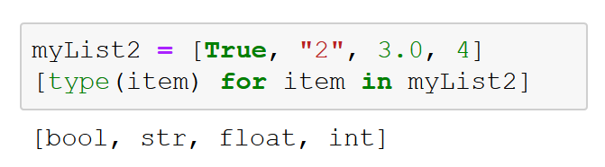
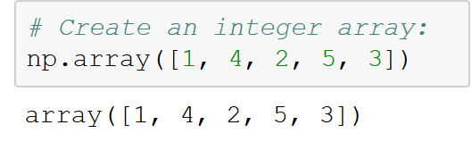
Arrays NumPy
Listas em Python:
Tipos de dados NumPy: floating point, integer, Boolean, string, objeto Python geral
Arrays de tipo fixo em Python:
Notes:
In Python, the types are dynamically inferred. The standard mutable multi-element container in Python is the list.
Lists are flexible, but they can become expensive in terms of memory and performance if we are dealing with hundreds of thousands or millions of items in a list. In contrast, NumPy arrays (also known as ndarrays) are efficient memory-wise and computationally.
Fixed type arrays can be created:
np.zeros
np.ones

Slide 10
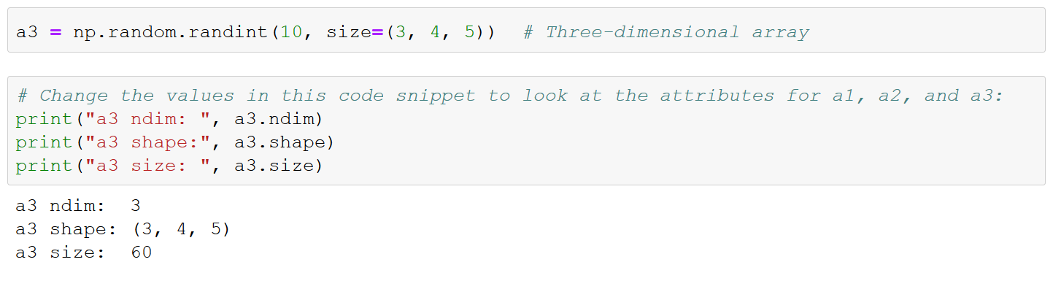
Atributos
Notes:
Array attributes
On this slide, we start by defining three arrays filled with random numbers: one one-dimensional, another two-dimensional, and the last three-dimensional. We then print out various attributes of the array.
Each array has attributes ndim (the number of dimensions), shape (the size of each dimension), and size (the total size of the array). Another useful attribute is the dtype, the data type of the array. Other attributes include itemsize, which lists the size (in bytes) of each array element, and nbytes, which lists the total size (in bytes) of the array.

Slide 11
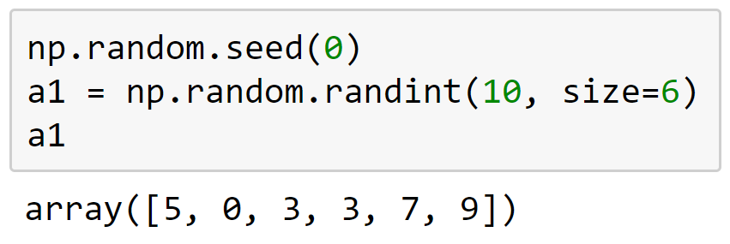
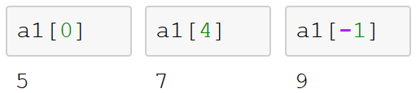
Indexação
Notes:
Indexing arrays: Getting and setting the value of individual array elements.
In a one-dimensional array, the 𝑖 th value (counting from zero) can be accessed by specifying the desired index in square brackets, just as with Python lists.

Slide 12
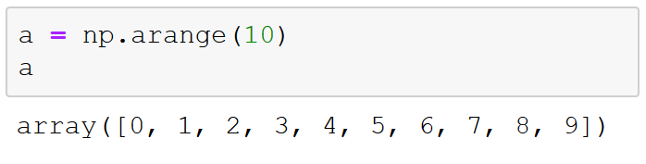
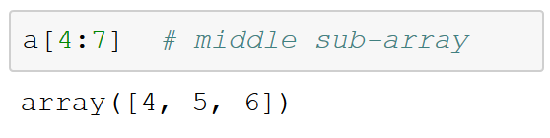
Fatiando arrays
Notes:
Slicing arrays: Getting and setting smaller subarrays within a larger array

Slide 13
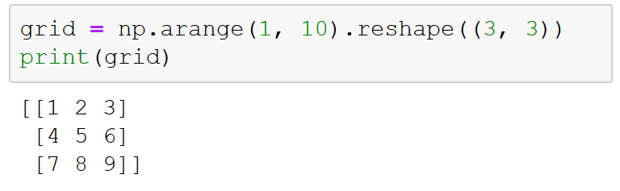
Reshaping (mudando forma)
Notes:
Reshaping arrays: Changing the shape of a given array
Note that, for this to work via the reshape method, the size of the initial array must match the size of the reshaped array.
Another common reshaping pattern is the conversion of a one-dimensional array into a two-dimensional row or column matrix. This can be done with the reshape method, or more easily done by making use of the newaxis keyword within a slice operation.

Slide 14
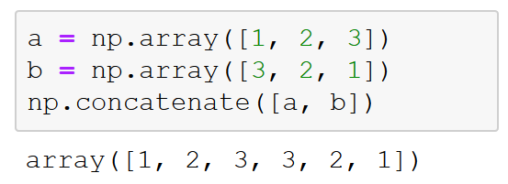
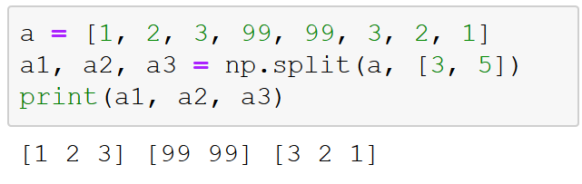
Concatenação e quebra
Notes:
Joining and splitting arrays: Combining multiple arrays into one and splitting one array into multiple arrays.
Concatenation, or joining of two arrays in NumPy, is primarily accomplished using the routines np.concatenate, np.vstack, and np.hstack. np.concatenate takes a tuple or list of arrays as its first argument.
The opposite of concatenation is splitting, which is implemented by the functions np.split, np.hsplit, and np.vsplit. For each of these, we can pass a list of indices giving the split points.

Slide 15
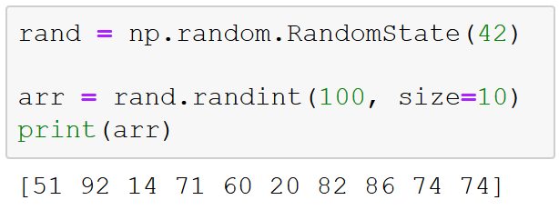
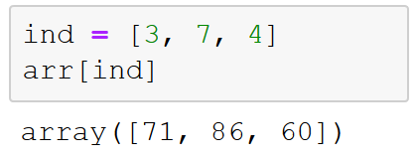
Fancy indexing (indexação sofisticada)
Notes:
In fancy indexing, we pass an array of indices to an array in order to access or modify multiple array elements at the same time.

Slide 16
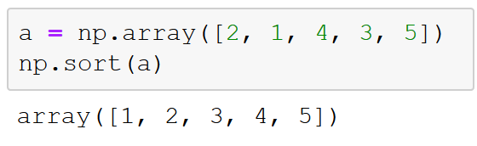
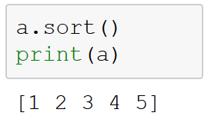
Ordenação
Notes:
So far, we have just worried about accessing and modifying NumPy arrays. Another huge thing you will need to do as a data scientist is sort array data. Although you could use Python's built-in sort and sorted functions, they will not work nearly as efficiently as NumPy's np.sort function. The np.sort function returns a sorted version of an array without modifying the input.
Or, to sort the array in-place, use the sort method directly on arrays.

Slide 17
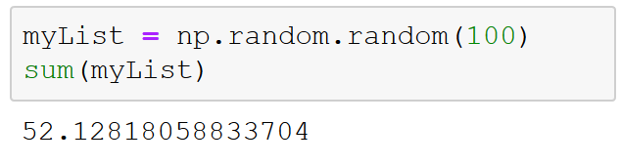
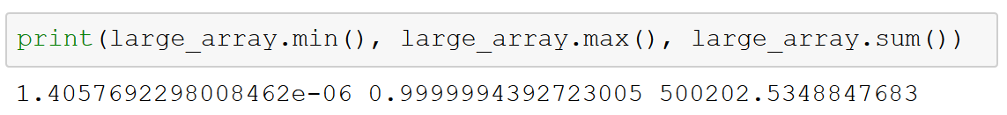
Agregações
Somando valores em arrays:
Valores mínimo e máximo:
Notes:
Aggregations
One of the first things you will find yourself doing with most datasets is computing the summary statistics for the data. These include the mean and standard deviation, in addition to other aggregates, such as the sum, product, median, minimum, and maximum, or quantiles of the data.
NumPy has fast built-in aggregation functions for working on arrays.
Summing the values of an array
You can use the built-in Python sum function to sum up the values in an array.
Minimum and maximum
Just as Python has built-in min and max functions, NumPy has similar, vectorized versions. You can also use min, max, and sum (and several other NumPy aggregates) as methods of the array object itself.

Slide 18
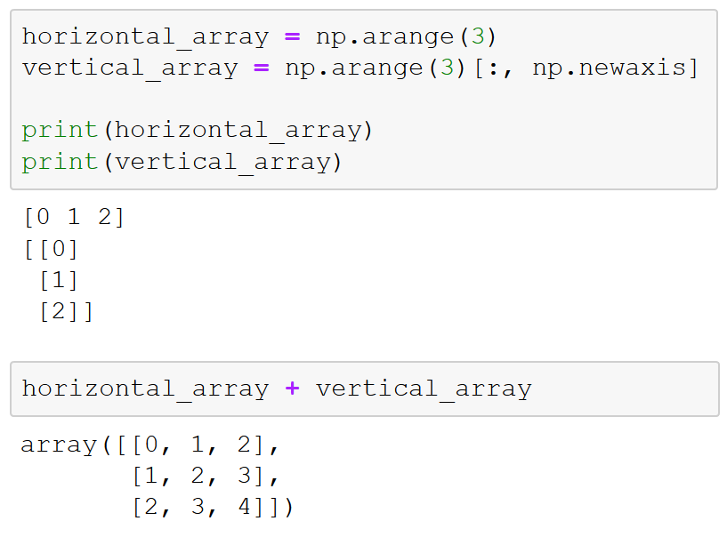
Broadcasting
Aplica operações sobre arrays de tamanhos diferentes:
"Preenche" (pads) dimensões dos arrays para que elas casem
"Estica" arrays unidimensionais
Notes:
Computation on arrays with broadcasting
Another means of vectorizing operations is to use NumPy's broadcasting functionality: creating rules for applying binary ufuncs like addition, subtraction, or multiplication on arrays of different sizes.

Slide 19
Intervalo
Voltaremos às 20:30
Notes:
Lembrar de colocar no mudo

Slide 20
Introdução a Pandas
Seção 2

Slide 21

Visão Geral da Seção 2
O principal serviço de streaming de video usa pandas and Jupyter notebooks para exploração, preparação e validação de dados
Notes:
Generic example
The leading online video-streaming service uses pandas and Jupyter notebooks for data exploration, preparation, and validation.
Specific example
Netflix uses pandas (and Jupyter notebooks) for data exploration, preparation, and validation: “data munging,” the subject of section 5 (https://medium.com/netflix-techblog/notebook-innovation-591ee3221233). Netflix also uses pandas as part of the wider Python scientific stack (NumPy, Scipy, scikit-learn, MatPlotLib, and pandas) for machine learning and automated analysis (https://medium.com/netflix-techblog/python-at-netflix-bba45dae649e).

Slide 22
Visão Geral da Seção 2
Por que pandas?
Biblioteca Python padrão para lidar e manipular dados gerais
Estrutura de dados tabular intuitiva (DataFrame)
Cálculos e transformações rápidos de dados usando NumPy
Boa integração com bibliotecas de visualização para exploração fácil dos dados
Notes:
Generic example
The leading online video-streaming service uses pandas and Jupyter notebooks for data exploration, preparation, and validation.
Specific example
Netflix uses pandas (and Jupyter notebooks) for data exploration, preparation, and validation: “data munging,” the subject of section 5 (https://medium.com/netflix-techblog/notebook-innovation-591ee3221233). Netflix also uses pandas as part of the wider Python scientific stack (NumPy, Scipy, scikit-learn, MatPlotLib, and pandas) for machine learning and automated analysis (https://medium.com/netflix-techblog/python-at-netflix-bba45dae649e).

Slide 23

Visão Geral da Seção 2
Estrutura de dados em pandas
Series
DataFrames
Manipulando dados
Em Series
Em DataFrames
Operações com dados
Preservação de índice
Alinhamento de índice
Operações entre Series e DataFrames

Slide 24
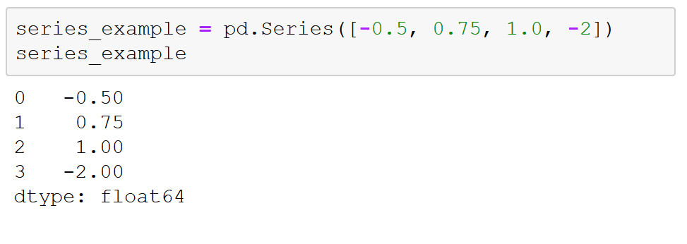
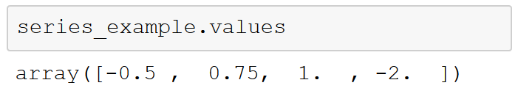
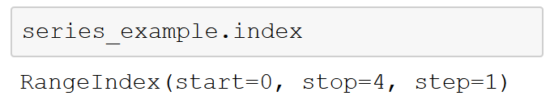
Series
Notes:
Both Series and DataFrames are a lot like the ndarrays you encountered in the last section. They provide clean, efficient data storage and handling at the scales necessary for data science. What both of them provide that ndarrays lack, however, are essential data-science features like flexibility when dealing with missing data and the ability to label data. These capabilities (along with others) help make Series and DataFrames essential to the “data munging” that makes up so much of data science.
Series objects in pandas
A pandas Series is a lot like an ndarray in NumPy: a one-dimensional array of indexed data. You can create a simple Series from an array of data.
Similar to an ndarray, a Series upcasts entries to be of the same type of data (that –2 integer in the original array became a – 2.00 float in the Series).
What is different from an ndarray is that a Series automatically wraps both a sequence of values and a sequence of indices. There are two separate objects within the Series object that you can access with the values and index attributes.

Slide 25
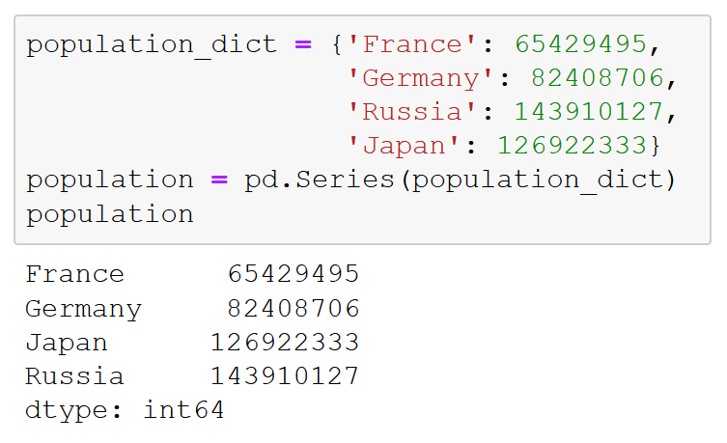
Series (a partir de dict)
Criando um DataFrame a partir de um dicionário:
Notes:
The DataFrame object in pandas
The other crucial data structure in pandas to get to know for data science is the DataFrame. Like the Series object, a DataFrame can be thought of as either a generalization of ndarrays or as specializations of Python dictionaries.
Just as a Series is like a one-dimensional array with flexible indices, a DataFrame is like a two-dimensional array with both flexible row indices and flexible column names. Essentially, a DataFrame represents a rectangular table of data, and it contains an ordered collection of labeled columns, each of which can be a different value type (such as string, int, and float). The DataFrame has both a row and column index; in this way, you can think of it as a dictionary of Series, all of which share the same index.

Slide 26
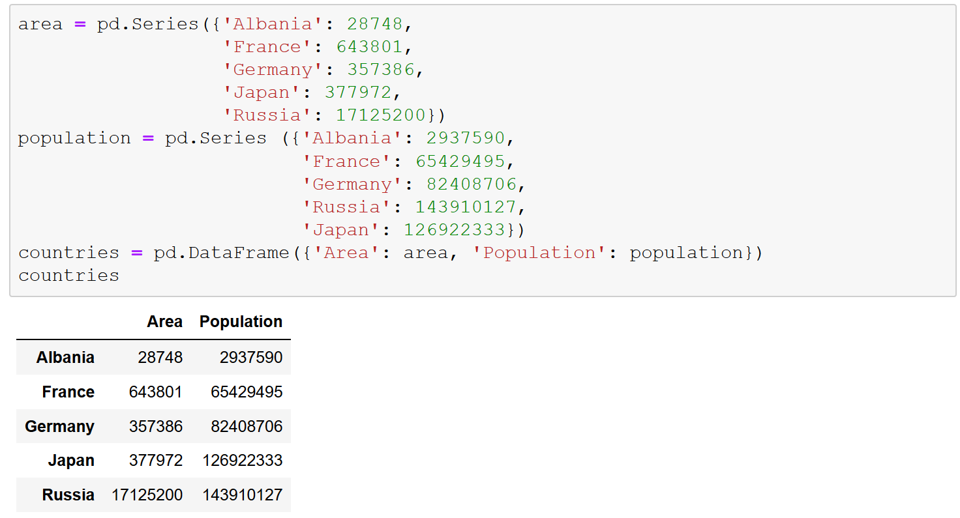
DataFrames (a partir de Series)
Criando um DataFrame a partir de um duas séries:
Notes:
The DataFrame object in pandas
The other crucial data structure in pandas to get to know for data science is the DataFrame. Like the Series object, a DataFrame can be thought of as either a generalization of ndarrays or as specializations of Python dictionaries.
Just as a Series is like a one-dimensional array with flexible indices, a DataFrame is like a two-dimensional array with both flexible row indices and flexible column names. Essentially, a DataFrame represents a rectangular table of data, and it contains an ordered collection of labeled columns, each of which can be a different value type (such as string, int, and float). The DataFrame has both a row and column index; in this way, you can think of it as a dictionary of Series, all of which share the same index.

Slide 27
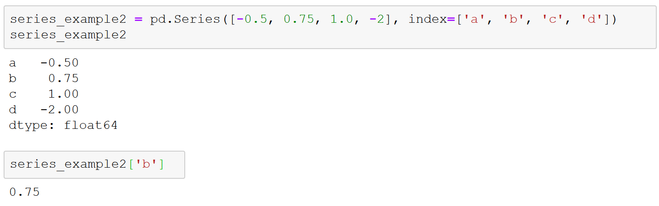
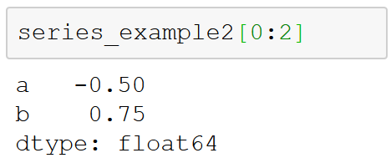
Seleção de dados em Series
Notes:
Data selection in Series
As a refresher, a Series object acts in many ways like both a one-dimensional ndarray and a standard Python dictionary.
Like a dictionary, the Series object provides a mapping from a collection of arbitrary keys to a collection of arbitrary values.
Because Series also provide array-style functionality, you can use the NumPy techniques we looked at in Section 3 like slices, masking, and fancy indexing.

Slide 28
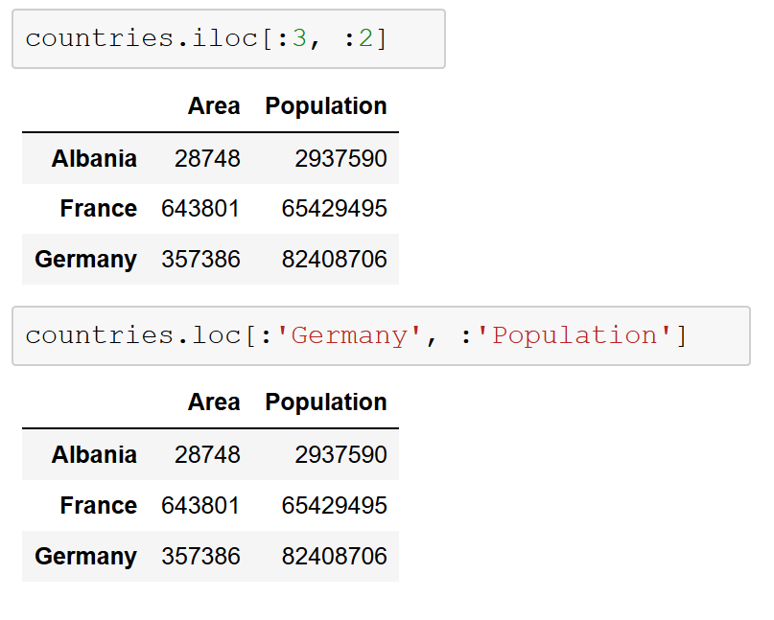
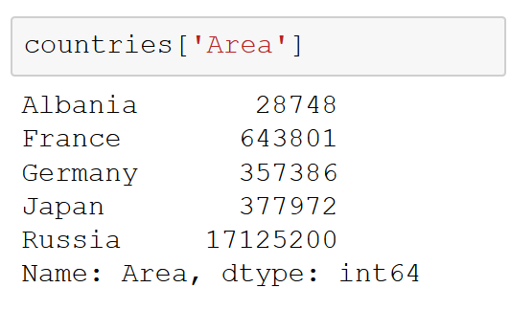
Seleção de dados em DataFrames
Notes:
See slide 41 for a complete DataFrame. Slide title: “Pandas data structures: DataFrames.”
DataFrames uses the loc and iloc indexers. With iloc, you can index the underlying array as if it were an ndarray, but with the DataFrame index and column labels maintained in the result.
loc also permits array-like slicing but using the explicit index and column names.

Slide 29
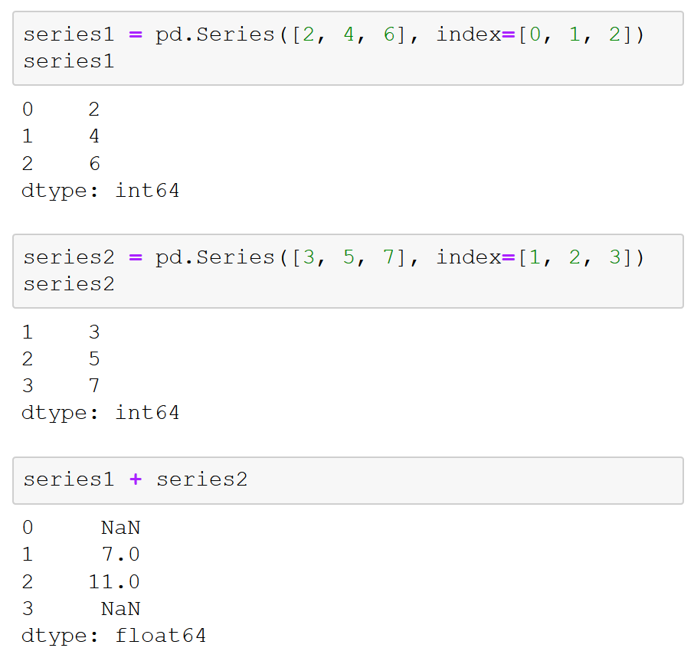
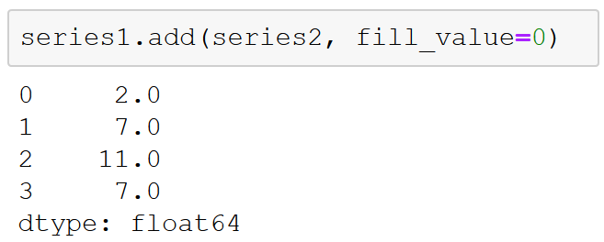
Alinhamento de índice
Notes:
Index alignment
When you perform a binary operation on two Series or DataFrame objects, pandas will align indices in the process of performing the operation. This is essential when working with incomplete data (and data is usually incomplete).
NaN values are not always convenient to work with; NaN, combined with any other values, results in NaN, which can be a pain, particularly if you are combining multiple data sources with missing values. To help with this, pandas allows you to specify a default value to use for missing values in the operation.
Index alignment with DataFrames
The same kind of alignment takes place in both dimensions (columns and indices) when you perform operations on DataFrames.

